Slide 1
Introduction to Python Unit 1
Course 40460

Slide 2
Module 1
Introduction to Python, Unit 1

Slide 3
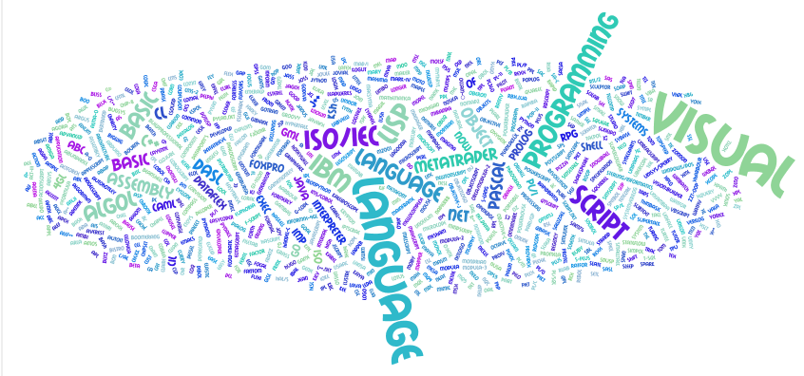
Programming languages
Notes:
This is a Wordle of a bunch of different programming languages and terms. Yes, there are a ton of them! Have students research the history of programming languages and how they have evolved over time. This can be done in groups. See activity sheet for more information.

Slide 4
What is Python?
A modern interpreted programing language, created in 1991 by Guido van Rossum.
Python 2 & 3 are actively used & improved by the Python community
Known for requiring less code to accomplish tasks than other languages
Principles:
Beautiful
Obvious
Allows programmer to be Simple
Allows programmer Complexity, without being complicated
Readable

Slide 5
Python Code in PowerPoint
programming code will be displayed with color highlighting
comment keyword string
function/reserved word
number, variable, operator

Slide 6
Functions
Remember math class? A function did what?
In programming we use functions too! A function is a mini program that runs and returns a value to your program.
print() is a function

Slide 7
Print Function
print() is used to display output to the user
Notes:
Example statement below introduces a new concept that needs discussion.

Slide 8
Print Function
In programming all data has a data type. There are several types but the most important categories number and text.
A string is a series of characters (including spaces). A string must be enclosed in quotes. The text above in the print function is a string.

Slide 9
Comments
A good program must be commented.
A comment is ignored by the interpreter or compiler. It is used by the coder to improve the readability of code.
In python we use # to denote a comment.

Slide 10
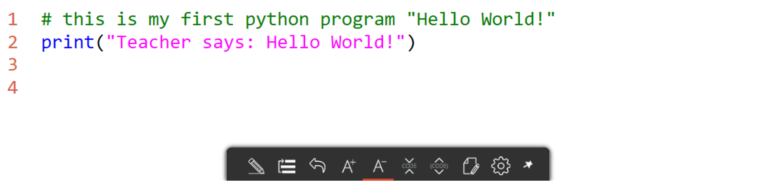
Comments
A good program must be commented.
A comment is ignored by the interpreter or compiler. It is used by the coder to improve the readability of code.
In python we use # to denote a comment.

Slide 11
Variables
What is a variable?
A placeholder for a value- remember math class?
x = 1
y = 4
z= x + y
In Python variables are used to store values.
The type of data stored is called the data type of the variable.

Slide 12
Three common data types
String (str)
A series of letters, numbers, and spaces. Always enclosed in quotes
Integer (int)
A whole number- no decimals.
Float (float)
A decimal number.
Notes:
note to students: strings use quotes, but int and float don't!

Slide 13
Variable assignment
To give a variable a value we use an assignment statement as seen below.
Do not give the variable a type. The interpreter will decide type based on the value entered.
Variables are case sensitive! Num1 and num1 are NOT the same variable!
Notes:
Some languages (C based languages for example) require a data type be given. These are called strongly typed languages. Python is Not one of these languages.

Slide 14
Why data types matter
A data type tells the interpreter what type of data to expect. It also tells the program that operations can be performed.
Example:
Why does this error occur?
Notes:
The output should be 3. But why does this error appear instead. Discuss the with students. Since quotes are used 2 is being defined as type String. A string cannot be added to an integer.

Slide 15
Why data types matter
A data type tells the interpreter what type of data to expect. It also tells the program that operations can be performed.
Example:
The quotes make all the difference! Num1 is a string. Strings cannot be added to integers.
Notes:
The output should be 0.5 (1/2). But why does this error appear instead. Discuss the with students. Since quotes are used 2 is being defined as type String. A string cannot be divided by an integer.

Slide 16
String addition
Strings can be added together. This is called concatenation.
This simply combines 2 strings into 1.
Example:
Spaces for proper structure must be added!
Notes:
Discuss that concatenation combines the strings exactly as they are. Spaces for correct structure must be added by the programmer.

Slide 17
Variable reassignment
To give a variable a new value simple write a new assignment statement
new value will overwrite the old value.

Slide 18
Using variables in print()
print() is a function
The print() function can also be used with variables and a combination of text and variables
Notes:
The plus is called the concatenation operator.

Slide 19

type() Function
Another built in Python function
Returns the data type of the given data or variable

Slide 20
Operators in variable assignment
Concatenation can also be preformed in assignment
Notes:
You have already seen an example of this (Slide 15) using addition in an assignment statement

Slide 21
Errors
When programmers code
errors are bound to happen
Three types of errors
Syntax
Run Time
Logic
Notes:
You have seen an example of an error already (slide 15)

Slide 22
Syntax error
Error in the rules of the language
using a keyword improperly
while = 3
failing to include a required item like a ":"
def hello_funtction()
print("hello world")
Illegal operation
if x=3:
Notes:
- keyword cannot be used as a variable name
function def needs a colon at end of: def hello_function():
- if needs a comparison x == 3 not assignment x = 3

Slide 23
Run time error
An error that causes a program to crash
Properly syntax but an illegal operation
Divide by zero
x = 3/0
Infinite loop
while True:
print("hello")
Notes:
divide by zero gives a ZeroDivisionError
infinite loop will lock up a browser using jupyter notebook and locks up most runtimes

Slide 24
Logic error
Hardest type of error to detect
Code is correct, but does not produce the expected results
Example:
The programmer thought x = 2 + y was the correct equation
when x = y - 2 was correct.
The program will run, but produce unintended results.
Notes:
common logic errors
switching greater than and less than (> for <)
not having a loop exit case such as x never equals 0 for a while x != 0: statement

Slide 25
Errors in python
TypeError
SyntaxError
NameError
TypeError
occurs when an illegal type operation is attempted
SyntaxError
occurs when unknown python code is used
NameError
occurs when a variable is used before it is declared or unknown command

Slide 26
TypeError
Most commonly occurs when attempt to do math operations with a string
Example:
Notes:
Strings cannot be subtracted- hence this error.

Slide 27
Character art
Using the print() function you can create character art.
Simply use the print function and multiple lines to create
the shape you want.

Slide 28
User Input
A main task programs need to perform is gathering input from the user
In Python use the input() function to gather input from the user
The program pauses and waits for user input.

Slide 29
Multiple Input Prompts
By storing inputs in variables the program can prompt the user for multiple pieces of information.
Simply use input statements in variable assignment statements.

Slide 30
Input Data Type
Input always returns a data type of string
Sometimes Python needs some help with data types and we have to convert the type, such as from String to Integer for example.
remember:
input() always returns type str (string)
Notes:
Input always returns a data type of string. No matter what the character entered.

Slide 31
Type Conversions
Python assigns the data type automatically. But what if Python is using the data in a way we don't want?
We must convert it using a type conversion where we cast the data type
To cast a data type – use the specific Type keyword ( like int or str) in front of the variable or data
Notes:
Note: int(grade1+grade2+grade3+grade4+grade5) does NOT work as a shortcut. This method will concatenate all the numbers as string, THEN convert it. So that int("1" + "1") = 11.
To Cast, is to convert from one data type to another

Slide 32
get the average
with a sum of grades stored as a number and calculated from 5 grades, the average can be calculated
average = sum / number of data points
What data type is average?
What does str(average) do?

Slide 33
Let’s get the average!
with a sum of grades stored as a number and calculated from 5 grades, the average can be calculated
average = sum / number of data points
What data type is average? Float
What does str(average) do? Convert to a string
Notes:
What data type is average? Float
What does str(average) do? Convert to a string

Slide 34
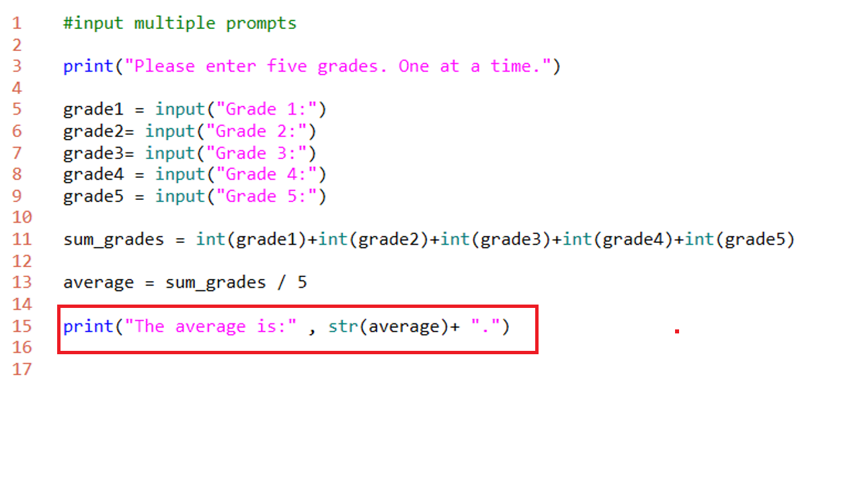
Print formatting
Besides string addition- we can concatenate in the print function with commas
comma (,) method
comma method combines
printable items with a space
Notice you can combine the
comma with string addition

Slide 35
Print formatting
Notice the space
output[]:
The average is: 94.6.
Notes:
a space is introduced between items joined by the comma formatting

Slide 36
Using a quote (“ or ‘) in a string
If you need to use the quote symbol in a string, how would you do that?
output[]:
I said to the class "sometimes you need to shutdown and restart a notebook when the cells refuse to run."
It's time to save your code
Notes:
Python will see a string end whenever a matching end quote is encountered
Python Strings can display double quotes by surrounding a string with single quotes
Python Strings can display single quotes by surrounding a string with double quotes

Slide 37
Boolean?
What is a Boolean?
What are the only possible outcomes?

Slide 38
Boolean?
What is a Boolean?
Data type with only 2 possible values
What are the only possible outcomes?
True or False
Notes:
Ture and False are Python key words – they are capitalized
Boolean is binary - only 2 outcomes

Slide 39
String Tests
Using Boolean methods we can test strings
.isalpha()
.isalnum()
.istitle()
.isdigit()
.islower()
.isupper()
.startswith()
Notes:
these methods return True or False

Slide 40

.isalpha()
Returns True if a string is an alphabetical character a-z, A-Z
"message" is an alpha, but 3 is not an alpha

Slide 41

.isalnum()
Returns True if there is at least 1 character and all are alphabetical or digits
“3rd“ is alphanumeric, but “!” is not

Slide 42

.istitle()
Tests to see if the string is title (all words capitalized)
Notes:
if any word starts lower case then .istitle( ) returns False

Slide 43

.isDigit()
Tests to see if the string is made entire of digits.
Notes:
decimal points are not digits so "3.14".isdigit( ) returns False

Slide 44
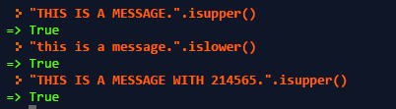
.isupper() and .islower()
These check for all uppercase or lowercase characters
Notes:
Notice digits are ignored. The last message still has all non numeric characters in uppercase.
Mixed case "I am a Message".isupper() is False

Slide 45

.startswith()
Does a string start with a certain character? We can check with .startswith()
Why is the second statement False?
Notes:
.startswith() is case sensitive
.startswith() can search a string with multiple characters as well "This is Python".startswith("This") is True

Slide 46
String Formatting
There are method to format strings in Python.
.capitalize() - capitalizes the first character of a string
.lower() - all characters of a string are made lowercase
.upper() - all characters of a string are made uppercase
.swapcase() - all characters of a string are made to switch case
upper becomes lower and vice versa
.title() - each 'word' separated by a space is capitalized
Notes:
note the similarity with the Boolean methods (.iscapital( ) is similar to .capitalize( ))

Slide 47
Combining Functions
Let’s say you have a program where you need the user’s name, but the program needs the input in all caps.
We can used nested function (a function within another function) to accomplish this.
output[]:
Please type your name Alton
ALTON
Notes:
message is a variable of type string which is being assigned the input asked of the user.
However we need all upper case. So we add .upper() at the end to make this happen

Slide 48
Another example using print
output[]:
Introduction To Python
Notes:
every word is capitalized

Slide 49
in
The in keyword allows a simple search to be preformed.
in returns a Boolean result on if the searched text is contained in a string.
output[]:
What is your name? My name is Eric
True
Notes:
the matching is case sensitive – using .lower( ) or .upper( ) can remove case sensitivity
print("eric" in message.lower( ))

Slide 50
Module 2
Introduction to Python, Unit 1

Slide 51
Arguments and Parameters
We have used various functions and methods so far: print(), type(), input(), .upper(), .isalpha(), etc.
After a function you might have noticed there are always ( )
Sometimes there is data passed in, sometimes not
Anything passed in the ( ) is called an argument
or it is called a parameter when defining a function
The input() function has 1 parameter: the message string to show the user
input() takes 1 argument such as "what is your name? ", a string
name_1 = input("what is your name?: ")
Notes:
parameter and argument are "sides of the came coin"
we define a parameter in a function: "this function has a integer parameter)
we pass an argument in a function call: "I am sending the function the integer argument 33"

Slide 52
User Defined Functions
A power of a programming language is being able to create functions
Functions allows code reuse. We can call a function again and again
Reuse makes programming more efficient and less prone to error
Notes:
we call print( ) instead of writing code to perform the duties of print( ). We avoid writing the several lines of code needed, over and over every time we want to display text.

Slide 53
Simple Function
To create a function use the def keyword.
Each line of the function under the definition MUST be indented. This is how Python knows it is part of the function.
To call a function, type the name of the function like a built-in function.
function call: get_name()
Notes:
This function asks the user for a name and then prints it. Very simple- expect that it can be called multiple times, but only coded once.

Slide 54
Example Function with Return
This simple function adds numbers, but returns a value to the function call
Notes:
num4 variable is assigned the value of the function call and stores the return value
<see next slide for further notes>

Slide 55
Breaking it Down
In the add_numbers() function the user is asked for 2 numbers which are added together. The return keyword is used to send the result back to the num4 variable
Why is type casting needed here?
Notes:
Num1 and num2 are variables gathering input from the user.
Num3 is the variable to hold the sum of the other 2 variables.
Since input is always of the string data type; it must be converted to an int.
Remember, if we add two strings concatenation occurs- which is not the desired result there.
All of this runs when the function is called by the assignment statement for num4 and stored in num4 variable

Slide 56
Code Reuse
We call the function more than once. This is the real power of a function
So now the function is called twice and all 4 numbers are added together.
But the addition code was only written once.

Slide 57
Functions with Parameters
Built-in functions like print() and type() take arguments.
User-defined functions can define parameters it will accept
Notes:
format_name( ) accepts 1 str argument – the parameter variable is called "name_input"
When calling the function the user doesn't need to know the parameter variable – just that it takes a string argument.
The parameter for this function is called "name_input" inthe function but it could be called "x" or any valid variable name.

Slide 58
Multiple Parameters
Separate each parameter with a comma.
The number of parameters passed must exactly match the number in the def statement or Python will throw an error. Unless a default value is defined.
Notes:
discuss default in a function definition
def forrmat_name(name_input = "Alton", age_input = "15"):

Slide 59
Module 3
Introduction to Python, Unit 1

Slide 60
Conditionals
In Python code, decisions can be made using a Boolean condition with if statement
This allows a programmer to control the flow of code through a program
Statements are either 100% True, or it is False - no maybe
Code either runs, or does not run
Notes:
Unlike humans, computers do not understand maybe.
Example: If it is sunny we will walk, otherwise we will take the bus.
One cloud in the sky.. Is this still sunny? Or Mostly sunny? What choice would the computer make?

Slide 61
Basic Form
If condition is true do x else do y
The colon ( : ) at the end of the if statement is required. Any lines of code that go with the if statement must be indented.

Slide 62
String Methods
Boolean string methods can be used in if statements
Notes:
This code ensures the user types a valid name. Well sort of.. What if we enter "335" at the name? Would the statement evaluate to true? <yes, because used isalnum( ) and not isalpha( )>

Slide 63
Compound if statements
It is possible to use two conditions at the same time using an and
the if statement reads:
"if name is alpha numeric and not a digit"
Notes:
Can decide to skip this slide if students still grasping simple if statements
can use and alone without not
and not are two key words that can be used independently - and not is the same as and !
example combinations:
if not name.isalnum( ):
print(….)
if name.isdigit( ):
print(….)
if name.isdigit( ) and name.isalpha( ):
print(…)

Slide 64
Compound if statements
It is possible to use two conditions at the same time using an or
or means either condition can be TRUE and the entire statement is TRUE
If age is smaller than18 or greater than 65 the statement is TRUE

Slide 65
Comparison Operators
Comparison operators in Python
> Greater than
< less than
>= Greater than to equal to
<= Less than to equal to
== Equals
!= Does not equal
Note: A single equals sign (=) is the assignment operator. Attempting to check for equality is a syntax error in Python

Slide 66
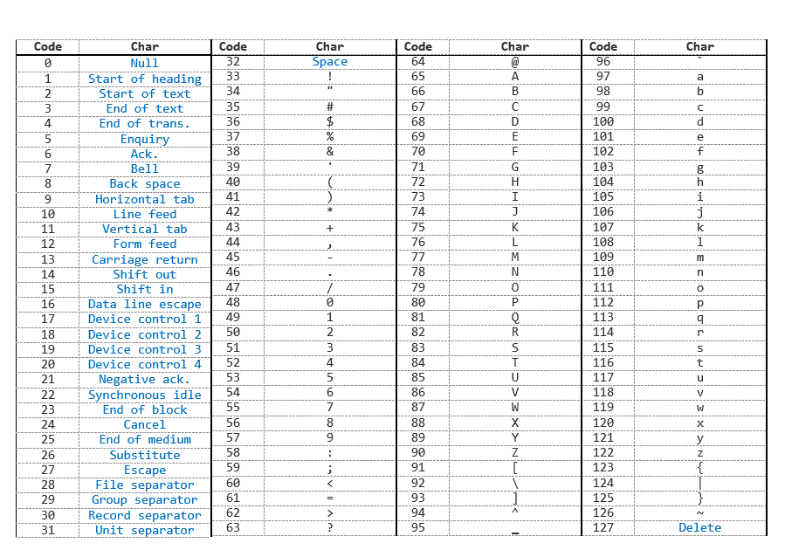
String Comparisons
Strings can be equal == or unequal != (not =)
Strings can be greater than > or less than <
alphabetically "A" is less than "B“
lower case "a" is greater than upper case "A"
Notes:
String comparisons actually look the binary number assigned to each letter using Unicode or ASCII. For example upper case “A” is 65 and lower case “a” is 97.

Slide 67
String Comparison Example
In this example two strings are compared using ==
Notes:
the comparison will include white space and is case sensitive

Slide 68
elif
What is there is more than one condition to test?
Using an else if, many conditions can be tested
In Python to accomplish this use the elif keyword.
Notes:
elif means "else if"
is the number 1? then is it 2? then is it 3? can be written
if x == 1:
print(1)
elif x == 2:
print(2)
elif x == 3:
print(3)
else:
print("I give up")

Slide 69
Python Calculator
Let’s write a simple Python program that will add, subtract, multiply, or divide 2 numbers! First, the functions.
Why is there an extra if statement for division?
Notes:
always avoid dividing by zero

Slide 70
Main program
Calling the calculator function
Notes:
See the file 1.5.2_Calc_Code_Full file for all the code in one file

Slide 71
You try it!
Code the calculator program on your own!
Notes:
Have students code the calculator program at their workstations. The code on slide 70 can be used as a guide. The full code is available in the 1.5.2_Calc_Code_Full file.

Slide 72
Module 4
Introduction to Python, Unit 1

Slide 73
Nested Conditionals
Sometimes a program might need to test a condition and a sub condition based on the answer the first decision.
Notes:
a sub question example: "is it cold?" if yes, "do you have a hat?"
Why is type casting required here?

Slide 74
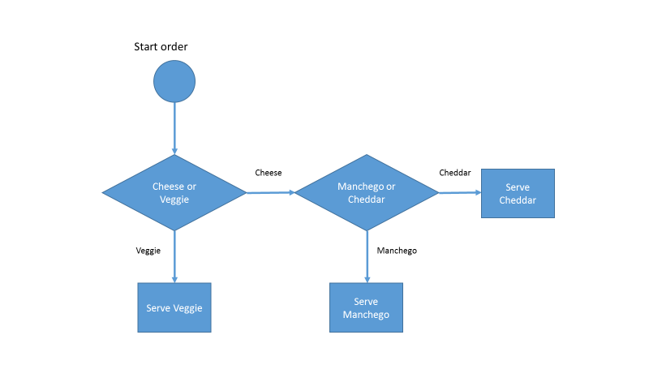
Example Flow Chart
Notes:
the meu shows Cheese or Veggie sandwiches
if you choose Cheese there are additional sub questions

Slide 75
Another Example
Notes:
Why is the double equals (==) used in the if statements? [compare is ==, assign is =]

Slide 76
Escape Sequences
Sometimes output needs to be formatted on multiple lines.
\n is the new line or carriage return
\n causes the print statement to start a new line
Notes:
See the notebook 1-6.2 for additional escape sequences

Slide 77
Loops
Loops, like conditionals, are fundamental concept in programing.
A common loop uses the while keyword

Slide 78
while Loop
while True: is known as the infinity loop
The break statement is critical. Otherwise this is an endless loop- a common logic error when coding with loops.
Notes:
A loop is endless when there is no way for it to become false (or terminate). The loop will run forever unless interrupted whichever comes first.
This is a pattern for forcing the user to enter valid input format

Slide 79
Incrementing Variables
A loop can also be controlled by a variable called a counter variable.
A variable can be increment or decremented as a loops run to set a condition to stop a loop.
For example using: while x < 10:
x is the counter variable we can increment by one each loop until it reaches 10 and the while condition becomes false
Notes:
while x < 10:
reads as: "while x is smaller than 10"
example

Slide 80
Increment a variable
increase the value of a variable
# initialize
x = 0
# increment
x = x + 1
There is also a shorthand way which is normally used
x += 1
Notes:
x += 1
is the same as
x = x + 1
can use x = x + 3 or x = x + y as
x += 3 or x += y

Slide 81
Decrement a variable
decrease the value of a variable
# initialize
x = 0
# decrement
x = x - 1
There is also a shorthand way which is normally used
x -= 1
Notes:
x -= 1
is the same as
x = x - 1
can use
x = x - 3 or x = x - y
as
x -= 3 or x -= y

Slide 82
Loop with Condition
x< 10 evaluates to True or False
What would the output of this loop be?
There is no break statement, why isn’t this loop endless?
Notes:
prints 0-9 digits
exits when x is 10 and condition is False

